Slide 1
Wine Quality Analysis
Insights from Physicochemical Properties of Red Wine
Presented by: Swati Dixit
Date: 03/01/2025

Slide 2
Introduction
To analyze the physicochemical properties of red wine and their impact on quality.
Dataset Overview:
Samples: 1599
Features: 11 physicochemical properties and 1 quality score
Quality Scale: 0 to 10

Slide 3
Key Questions
What are the general characteristics of wine quality in the dataset?
How do certain features correlate with wine quality?
What insights can we derive from residual sugar and volatile acidity?
Can we predict wine quality using machine learning models?

Slide 4
General Characteristics
Findings:
Most frequent wine quality: 5
Quality range: 3 to 8
Distribution is skewed towards mid-range quality scores (e.g., 5 to 6).

Slide 5
Correlation Analysis
Insights:
Fixed Acidity vs. Quality: Weak positive correlation (0.12)
Alcohol Content vs. Quality: Strong positive correlation (0.48)
Free Sulfur Dioxide: Weak correlation (-0.05)

Slide 6
Residual Sugar Analysis
key Findings:
Average residual sugar for highest quality wine: 3.6 g/L
Average residual sugar for lowest quality wine: 2.2 g/L
Volatile Acidity Impact
Insights:
High volatile acidity generally correlates with lower wine quality.
Mean volatile acidity decreases as quality improves.

Slide 7
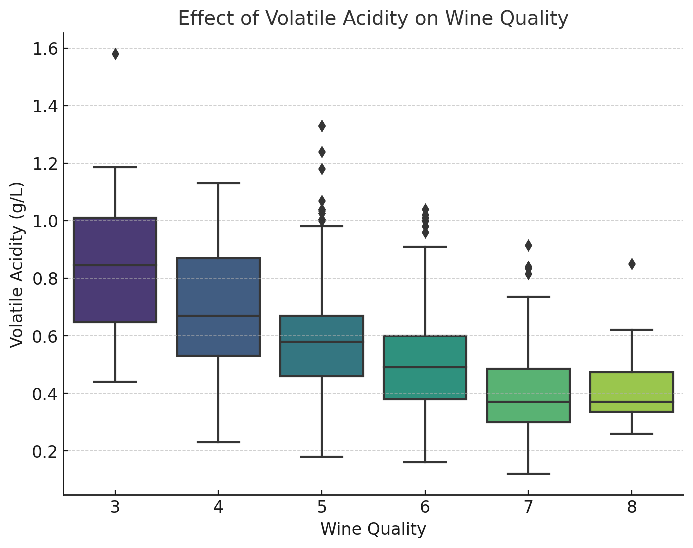
Effect of Volatile Acidity on wine quality

Slide 8
Predictive Modeling
Models Trained:
1. Decision Tree Classifier
2. Random Forest Classifier
Results:
Decision Tree Accuracy: 62.5%
Random Forest Accuracy: 70.3%
Feature Importance: Alcohol and Volatile Acidity were top predictors.

Slide 9
Conclusions and Recommendations
Conclusions:
Alcohol content significantly affects wine quality.
Fixed acidity and residual sugar play a moderate role.
Machine learning models provide reliable predictions.
Recommendations:
Enhance focus on optimizing alcohol content during production.
Monitor volatile acidity to ensure consistent quality.

Slide 10
Thank You

